Slide 1
Naïve Bayes Classification
Subtitle

Slide 2
RECAP = Supervised Learning Algorithms
All classification and regression algorithms come under supervised learning.
Logistics Regression
Decision Trees
Support Vector Machine (SVM)
K- Nearest Neighbors
Naïve Bayes (Classification)
Random Forest
Linear Regression
Polynomial Regression
SVM for Regression

Slide 3
Primary Uses
Text classification
E.g, spam filtering, sentiment analysis, classification of news articles
Medical Diagnosis
Given a list of symptoms, predict whether a patient has disease X or not
Weather
Based on temperature, humidity, etc… predict if it will rain tomorrow

Slide 4
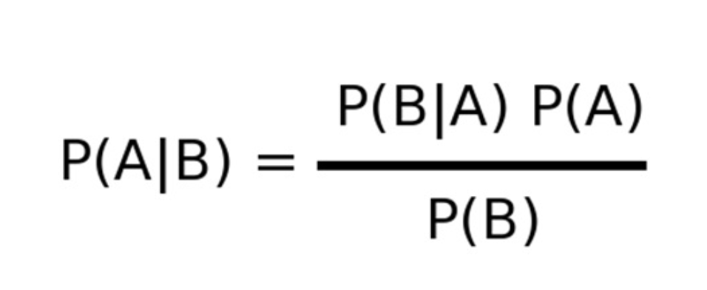
Bayes Theorem
Prob that A occurs that given that B occured

Slide 5
Exercise
What is the probability of picking a Queen from the pack of cards?
What is the probability of picking a Queen given the card picked in a face card?

Slide 6
What is the probability of picking a Queen given the card picked in a face card?
P(Queen/Face) = [P(Face/Queen) * P(Queen)]/P Face
P Queen = 4/52 =1/13
P(Face/Queen] == 1
P(Face) = 12/52 = 3/13
P(Queen/Face) = [1 x 1/13] /3/13 = 1/3

Slide 7
Bowl 1 → 2 Red , 4 Blue
Bowl 2 → 1 Red, 2 Blue
Bowl 3 → 5 Red, 4 Blue
What is the probability of selecting a Red marble
What is the probability (Bowl 1 / given that marble selected was Red)

Slide 8
Prob (selecting a red) = 1/3x 2/6 + 1/6 * 1/3 + ½ * 5/9
Probability (Bowl1/Red) = P(Red/Bowl1) * P(Bowl1)/P(Red)
P(Red/Bowl1 ) = 2/6
P(B1) = 1/3

Slide 9
Probability Basics
Prior, conditional and joint probability for random variables
Prior probability:
Conditional probability:
Joint probability:
Relationship:
Independence:
Bayesian Rule
Discriminative
Generative

Slide 10
Probabilistic Classification Principle
Establishing a probabilistic model for classification
Discriminative model
To train a discriminative classifier regardless its probabilistic or non-probabilistic nature, all training examples of different classes must be jointly used to build up a single discriminative classifier.
Output L probabilities for L class labels in a probabilistic classifier while a single label is achieved by a non-probabilistic classifier .
Discriminative
Probabilistic Classifier

Slide 11
Probabilistic Classification Principle
Establishing a probabilistic model for classification (cont.)
Generative model (must be probabilistic)
L probabilistic models have to be trained independently
Each is trained on only the examples of the same label
Output L probabilities for a given input with L models
“Generative” means that such a model produces data subject to the distribution via sampling.
Generative
Probabilistic Model
for Class 1
Generative
Probabilistic Model
for Class L

Slide 12
Probabilistic Classification Principle
Maximum A Posterior (MAP) classification rule
For an input x, find the largest one from L probabilities output by a discriminative probabilistic classifier
Assign x to label c* if is the largest.
Generative classification with the MAP rule
Apply Bayesian rule to convert them into posterior probabilities
Then apply the MAP rule to assign a label
Common factor for all L probabilities

Slide 13
Naïve Bayes
Bayes classification
Difficulty: learning the joint probability is infeasible!
Naïve Bayes classification
Assume all input features are class conditionally independent!
Apply the MAP classification rule: assign to c* if
Applying the independence assumption
Notes:
For a class, the previous generative model can be decomposed by n generative models of a single input.

Slide 14
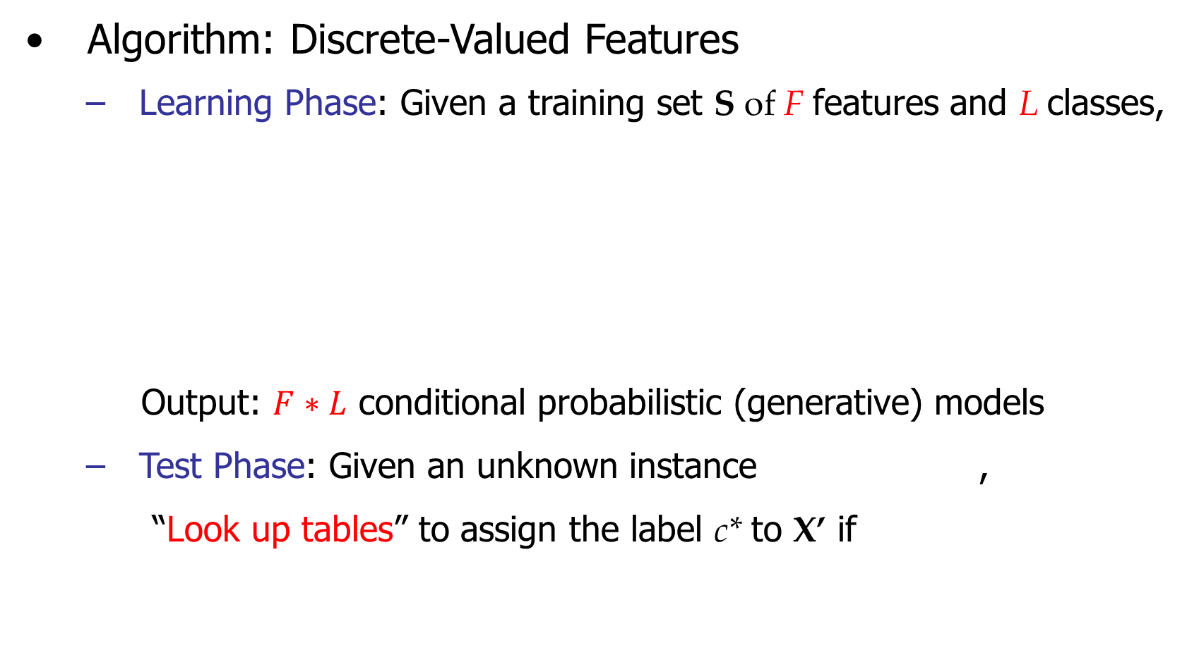
Naïve Bayes

Slide 15
Why is it called so?
Naïve Bayes algorithm is called Naïve because it makes the assumption that the occurrence of certain feature is independent of the occurrence of other sets of variables
E.g., if you are trying to identify a fruit based on its color, shape and taste - an orange color, spherical, tangy fruit can be classified as “Orange”. All the features independently contribute to the probability that the fruit is orange
Base part is based on Bayes’s theorem

Slide 16
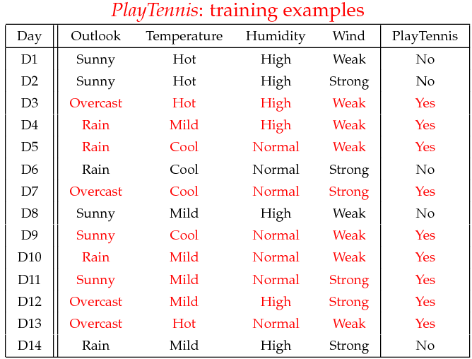
Example
Example: Play Tennis

Slide 17
Example
Learning Phase
Outlook | Play=Yes | Play=No
Sunny | 2/9 | 3/5
Overcast | 4/9 | 0/5
Rain | 3/9 | 2/5
Temperature | Play=Yes | Play=No
Hot | 2/9 | 2/5
Mild | 4/9 | 2/5
Cool | 3/9 | 1/5
Humidity | Play=Yes | Play=No
High | 3/9 | 4/5
Normal | 6/9 | 1/5
Wind | Play=Yes | Play=No
Strong | 3/9 | 3/5
Weak | 6/9 | 2/5
P(Play=Yes) = 9/14
P(Play=No) = 5/14

Slide 18
Example
Test Phase
Given a new instance, predict its label
x’=(Outlook=Sunny, Temperature=Cool, Humidity=High, Wind=Strong)
Look up tables achieved in the learning phrase
Decision making with the MAP rule
P(Outlook=Sunny|Play=Yes) = 2/9
P(Temperature=Cool|Play=Yes) = 3/9
P(Huminity=High|Play=Yes) = 3/9
P(Wind=Strong|Play=Yes) = 3/9
P(Play=Yes) = 9/14
P(Outlook=Sunny|Play=No) = 3/5
P(Temperature=Cool|Play==No) = 1/5
P(Huminity=High|Play=No) = 4/5
P(Wind=Strong|Play=No) = 3/5
P(Play=No) = 5/14
P(Yes|x’) ≈ [P(Sunny|Yes)P(Cool|Yes)P(High|Yes)P(Strong|Yes)]P(Play=Yes) = 0.0053
P(No|x’) ≈ [P(Sunny|No) P(Cool|No)P(High|No)P(Strong|No)]P(Play=No) = 0.0206
Given the fact P(Yes|x’) < P(No|x’), we label x’ to be “No”.

Slide 19
Naïve Bayes
Algorithm: Continuous-valued Features
Numberless values taken by a continuous-valued feature
Conditional probability often modeled with the normal distribution
Learning Phase:
Output: normal distributions and
Test Phase: Given an unknown instance
Instead of looking-up tables, calculate conditional probabilities with all the normal distributions achieved in the learning phrase
Apply the MAP rule to assign a label (the same as done for the discrete case)

Slide 20
Naïve Bayes
Example: Continuous-valued Features
Temperature is naturally of continuous value.
Yes: 25.2, 19.3, 18.5, 21.7, 20.1, 24.3, 22.8, 23.1, 19.8
No: 27.3, 30.1, 17.4, 29.5, 15.1
Estimate mean and variance for each class
Learning Phase: output two Gaussian models for P(temp|C)

Slide 21
Zero conditional probability
If no example contains the feature value
In this circumstance, we face a zero conditional probability problem during test
For a remedy, class conditional probabilities re-estimated with
(m-estimate)

Slide 22
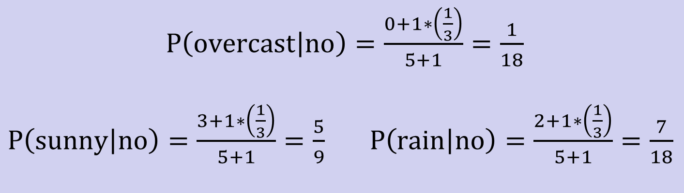
Zero conditional probability
Example: P(outlook=overcast|no)=0 in the play-tennis dataset
Adding m “virtual” examples (m: up to 1% of #training example)
In this dataset, # of training examples for the “no” class is 5.
We can only add m=1 “virtual” example in our m-esitmate remedy.
The “outlook” feature can takes only 3 values. So p=1/3.
Re-estimate P(outlook|no) with the m-estimate

Slide 23
Summary
Probabilistic Classification Principle
Discriminative vs. Generative models: learning P(c|x) vs. P(x|c)
Generative models for classification: MAP and Bayesian rule
Naïve Bayes: the conditional independence assumption
Training and test are very efficient.
Two different data types lead to two different learning algorithms.
Working well sometimes for data violating the assumption!
Naïve Bayes: a popular generative model for classification
Performance competitive to most of state-of-the-art classifiers even in presence of violating independence assumption
Many successful applications, e.g., spam mail filtering
A good candidate of a base learner in ensemble learning
Apart from classification, naïve Bayes can do more…

Slide 24
Prob (yes) =9/14
Prob(no) = 5/14
Outlook | Temp | Humidity | Windy | Play Golf
Rainy | Hot | High | False | No
Rainy | Hot | High | True | No
Overcast | Hot | High | False | Yes
Sunny | Mid | High | False | Yes
Sunny | Cool | Normal | False | Yes
Sunny | Cool | Normal | True | No
Overcast | Cool | Normal | True | Yes
Rainy | Mild | High | False | No
Rainy | Cool | Normal | False | Yes
Sunny | Mild | Normal | False | Yes
Rainy | Mild | Normal | True | Yes
Overcast | Mild | High | True | Yes
Overcast | Hot | Normal | False | Yes
Sunny | Mild | High | True | No
Outlook | Yes | No
Rainy | 2 | 3
Overcast | 4 | 0
Sunny | 3 | 2
P(Rainy) | 2/9 | 3/5
P(overcast) | 4/9 | 0
P(Sunny) | 1/3 | 2/3
Label
Temp | Yes | No
Hot | 2 | 2
Mild | 4 | 2
Cool | 3 | 1
P(Hot) | 2/9 | 2/5
P(Mild) | 4/9 | 2/5
P(Cool) | 1/3 | 1/5
P sunny day playing golf
Humidity | Yes | No
High | 3 | 4
Normal | 6 | 1
P(Hig Hum) | 1/3 | 4/5
P(Nor Hum) | 2/3 | 1/5
Windy | Yes | No
False | 6 | 2
True | 3 | 3
P(not Windy) | 2/3 | 2/5
P(windy) | 1/3 | 3/5

Slide 25
What is the probability of playing golf on a day which is
Sunny
Cool
Humidity High
Not Windy (Windy = False)
It is = 2/9 x 1/3 x1/3 x 1/3 x 9/14
Prob(not playing) = 3/5x1/5x4/5x3/5x5/14

Slide 26
Bayesian Classification
Problem statement:
Given features X₁,X₂,…,X_{n}
Predict a label Y
It is a probabilistic classifier

